Slide 1

The Secret of
Microsoft’s Success
Kai-Fu Lee
Corporate Vice President
Microsoft Corporation

Slide 2









微软的理想
Microsoft Vision
通过优秀的软件（在任何时间、任何地点、通过任何设备）帮助人们发挥潜力
Help People Realize their Potential by Empowering people through great software - any time, any place and any device
2004
1995

Slide 3















微软的七个商业分部
Seven Business Group
个人电脑软件
操作系统
办公室软件
商用软件
服务器&工具
商业解决方案
消费者&硬件
微软网站
家庭及娱乐
移动通讯

Slide 4
微软营业
Microsoft Business
Market capitalization:
$310 billion
Fiscal Year ending June 30, 2004
Net Revenue $36.8 billion
Net Income $8.2 billion
14% Y-Y Revenue Growth
R&D Spending: $7.7 billion
Cash & dividends:
$65 billion ($33 billion dividend next month)

Slide 5
Secrets of Microsoft’s Success
Technology leadership
Focus & accountability
Bill & Steve
Focus on people
Microsoft values

Slide 6
Secrets of Microsoft’s Success
Technology leadership
Focus & accountability
Bill & Steve
Focus on people
Microsoft values

Slide 7
Technology Leadership
Why is technology leadership important?

Slide 8









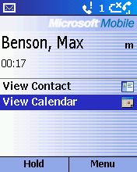


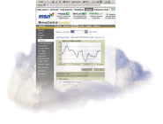

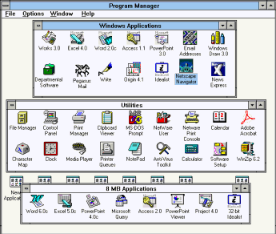





Speech/Writing
Technology Leadership &
Waves of Innovation
Devices everywhere
Wi-Fi/Broadband
Web Services
Trusted Computing Hardware
Rights Management
Research & Development
Engineering → Intellectual Property
XML/SOAP
HTTP/HTML
SMTP
Websites, content, music, search....
Email, IM, Chat, P2P…
Mouse
GUI
LANs
Databases
Desktop publishing
Enterprise applications
Server applications
PC Architecture
Operating Systems
Programming languages
Spreadsheets
Word Processors
Market Adoption
Intellectual Property → Economic Value
Applications
1990
Internet
1995
Seamless Computing
2005
PC
1980

Slide 9




























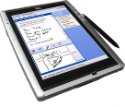
Seamless Computing: The Next Wave
Person-to-Person
Interaction
Connected
Person-to-Machine
Interaction
Machine-to-Machine Interaction
Content
Addressability
Information Driven
Self-organization
Replication
Speech & Intelligent UI
Amazing visualization
Experiences
Ink &
Handwriting
Notes:
Smart devices expands software beyond computing.
Structured content makes information accessible.
Web services makes Internet the computing platform.
Smart services turns software from tool to assistant.

Slide 10
Technology Leadership
Why is technology leadership important?
Long-term roadmap
  Think week, Bill’s projections
Research investment & management
  World’s best research labs
Product management
  Know-how in building large-scale software
Research → product transfer

Slide 11
Secrets of Microsoft’s Success
Technology leadership
Focus & accountability
Bill & Steve
Focus on people
Microsoft values

Slide 12
Focus & Accountability
Pure-play software company
  Basically no content, hardware, system integration
  Everything we do is to support software
  Core software investment is platform
Accountability
  Measurable, objective, succinct goals
  Broad sharing of objectives
  Decision making framework
    Owner, approver, reviewer, participant

Slide 13
Secrets of Microsoft’s Success
Technology leadership
Focus & accountability
Bill & Steve
Focus on people
Microsoft values

Slide 14
Bill & Steve
Bill
  Technical leadership (Thinkweek)
  Technical priorities & investments across 7 divisions
  From “ship review” to “brainstorming meeting”
Steve
  Microsoft’s #1 cheerleader’s
  Empowerment of 7 divisional leaders
  Focus on values, people
Unique “Bill & Steve” qualities
  Adaptability
  Passion for the company
  Trust in each other

Slide 15
Secrets of Microsoft’s Success
Technology leadership
Focus & accountability
Bill & Steve
Focus on people
Microsoft values

Slide 16
Focus on People：(以人为本)
People-centered
  Value of “people” increasing in Information Age
  Recruiting of top people is #1 management priority
  People review, people statistics
  Importance of campus hiring & employee development
Hiring
  A’s hire A’s, B’s hire C’s
  Hire smart people, not just experts
  Each hire should increase team quality
  Hire people who’re better than you (in some way)
Meritocracy
  Merit, not seniority based (high length-in-level is a liability)
  Differentiate top & bottom performers
  Applied to all employees （以身作则）

Slide 17
Focus on People：(人尽其才)
Dual track development
  Management & technical are completely parallel
  Best technical people need not become managers
Encourage technical people to follow passion
  Research, development, architecture, testing, support
Encourage managers to broaden
  “Baseball card” development plan
  Move managers to new areas to prepare for growth

Slide 18
Secrets of Microsoft’s Success
Technology leadership
Focus & accountability
Bill & Steve
Focus on people
Microsoft values

Slide 19
Microsoft Values
Integrity & Honesty
Open & Respectful with others and dedicated to making them better
Willing to take on big challenges
Passion for customers, partners, and technology
Accountable for commitments and results to customers, shareholders, partners and employees
Self critical, questioning, & committed to personal excellence and self-improvement

